Slide 1



Moms Demand CAP Laws: An Analysis of Child-Access Prevention Legislation
Rohin Mishra
Rohin Mishra

Slide 2

Table of Contents
Background
Research Question
Literature Review
Research Design
Methodology/Findings
Limitations
Recommendations

Slide 3


Background

Slide 4
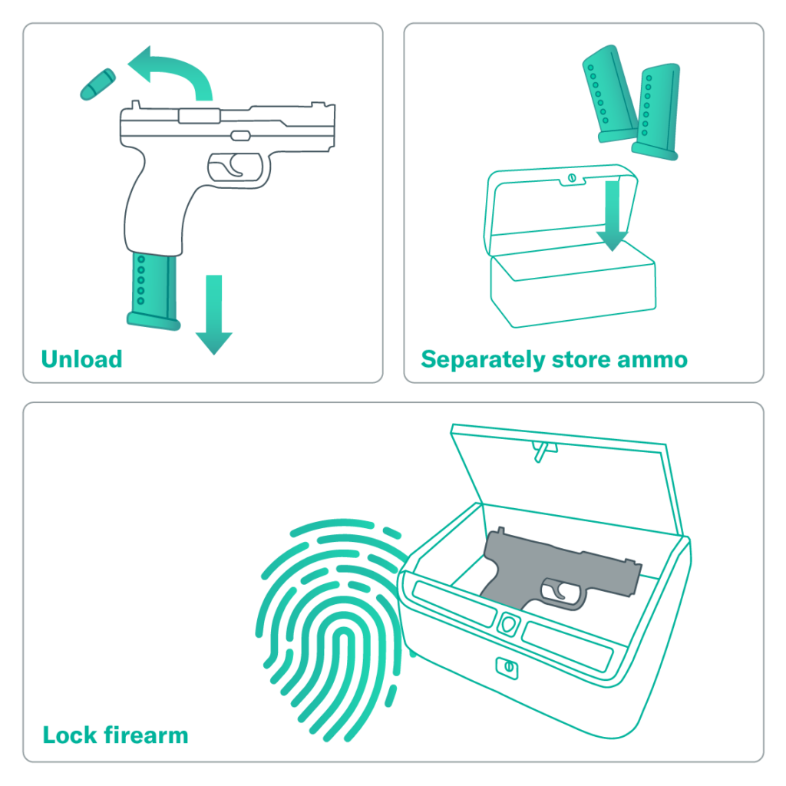
What are CAP Laws?
Child-access prevention (CAP) and safe storage laws allow prosecutors to bring charges against adults who intentionally or carelessly allow children to have unsupervised access to firearms.​
In 2020, firearm injuries surpassed motor vehicle crashes as the leading cause of death among children aged 1 to 17 years (Lee, Douglas, and Hemenway, 2022). ​
Of the 2,590 children under age 18 who were killed by firearms in 2021, 827 (31.9 percent) of those deaths were classified as suicides.

Slide 5

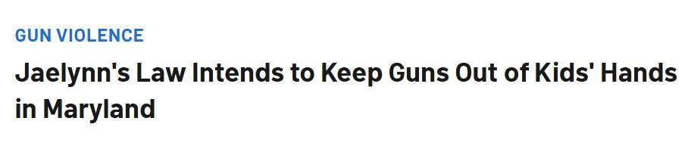
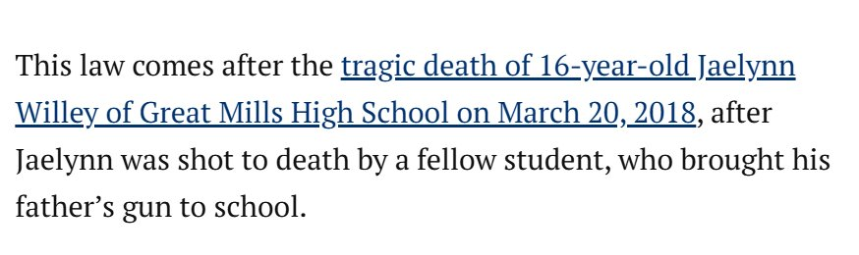
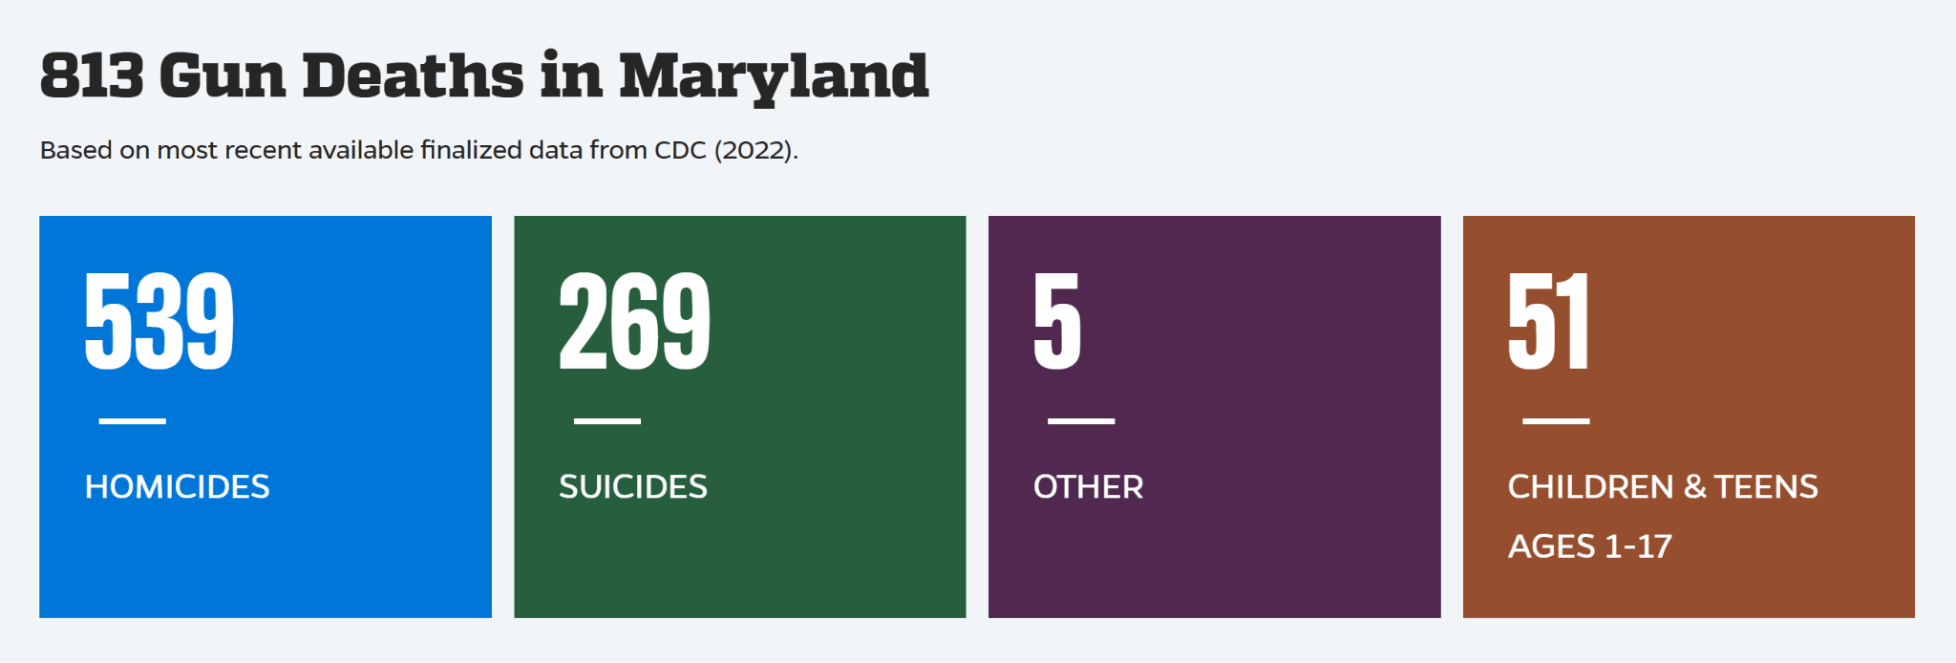
Jaelynn’s Law (2023)
Although Maryland has had child-access prevention laws on the books, it strengthened them in the 2023 legislative session with Jaelynn’s Law.
Moms Demand Action was instrumental in getting this law passed in Maryland, but pushing similar legislation is not necessarily a legislative priority as opposed to advocating personal responsibility.
.

Slide 6
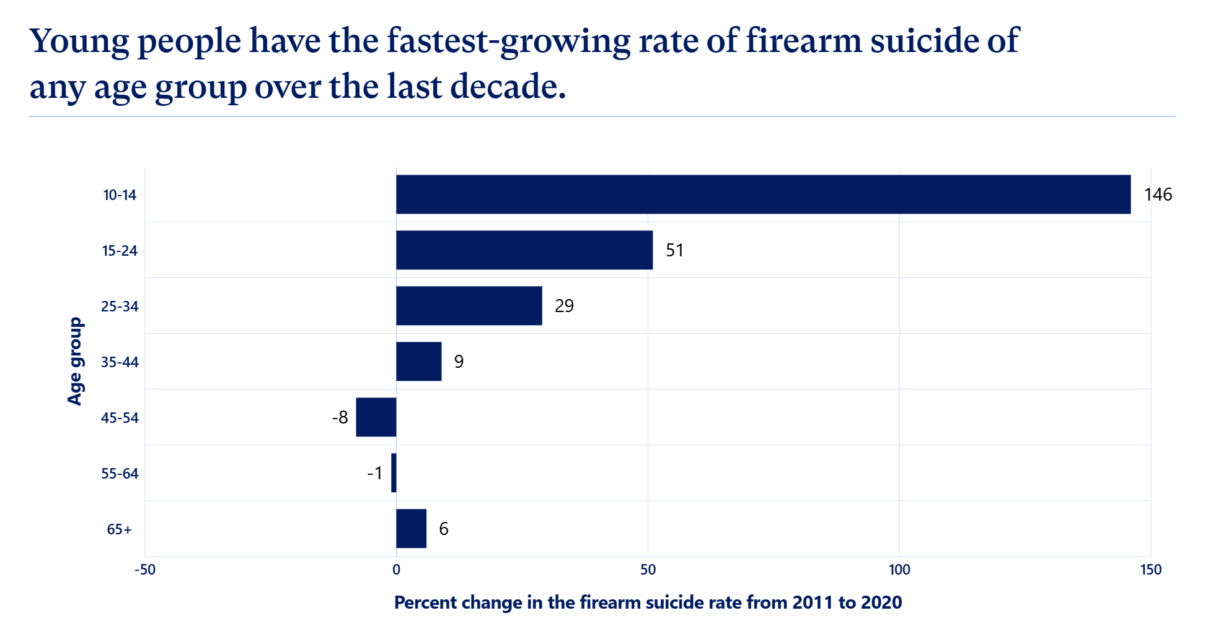

Slide 7
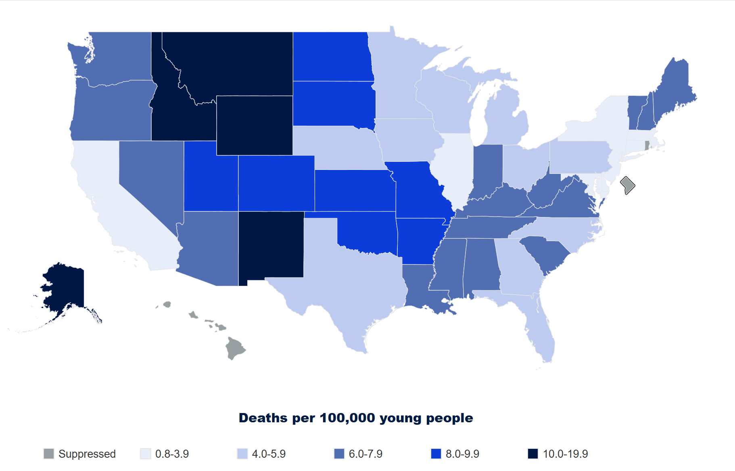
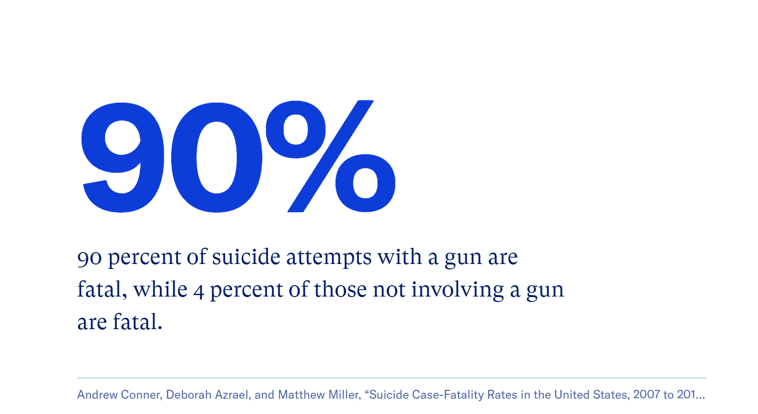
Focus: Youth Firearm Suicide

Slide 8
Research Question

Slide 9
Research Questions and Hypothesis
Firstly: Do CAP laws work?
How do we determine success?
If they do work, can we determine to what extent they do so?
Do CAP laws cause fewer firearm-related incidents, or might they merely be correlated?
If we’re implementing laws, we want to know that they work.
Hypothesis to assess:
Child-access prevention laws cause lower youth suicide rates.

Slide 10
Literature Review

Slide 11
Prior Literature
Webster (2004)
Knopov et al. (2019)
CAP laws were associated with an 8.3% decrease in suicide rates among 14- to 17-year-olds. This association was statistically significant for firearm suicides, but not for nonfirearm suicides. CAP laws were also associated with a significant reduction in suicides among youth aged 18 through 20 years.​
Access to firearms is strongly associated with higher youth (ages 10 to 19) suicide rates: For each 10 percent increase in household gun ownership in a state, the youth suicide rate increased by more than 25 percent.
Schnitzer et al. (2019)
Sidman et al. (2005)
Data from the National Fatality Review Case Reporting System from 2004 to 2015 showed that, among firearm suicides by children ages 10 through 18 for which storage practices could be identified, more than three-fourths involved the use of a gun that had been stored loaded and unlocked.
The only rigorous evaluation of a national-level media campaign promoting safe firearm storage (a la Be SMART). The evaluation did not find the campaign to have statistically significant effects on improving safe storage practices.

Slide 12
Research Design

Slide 13


Youth Suicide Rates
CDC WONDER Database, Multiple Cause of Death 1999-2020 10-24 year olds
Child-Access Prevention Laws
State Firearm Law Database: State Firearm Laws, 1991-2019. ICPSR
Demographic Data
Census (2000), ACS-1 (2005-2019), ACS Imputation (1999, 2001-2004)
Everytown Research & Policy
Establishing priors re: research and methodology, MDA Partner
RAND Corporation
Establishing priors re: research and methodology
Johns Hopkins Bloomberg School of Public Health
Establishing priors re: research and methodology

Slide 14
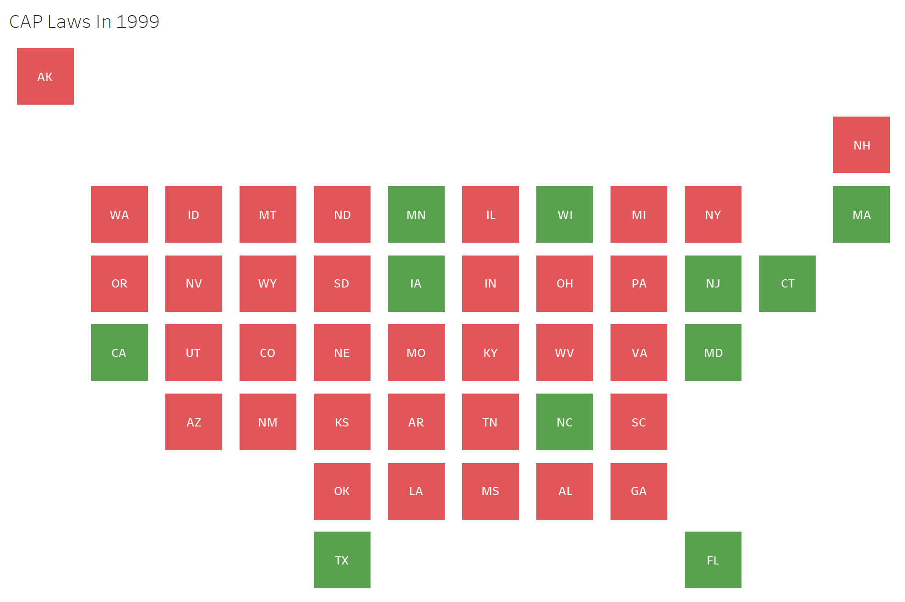
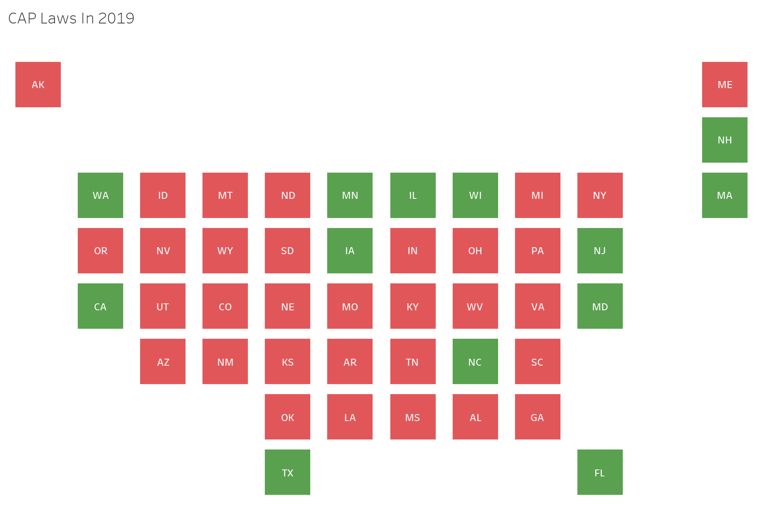

Few Introductions of CAP laws
States were more likely to strengthen or adjust CAP laws than they were to outright introduce them over this time period.
Some introduced them more recently: Oregon (2021), New Mexico (2023), etc.

Slide 15
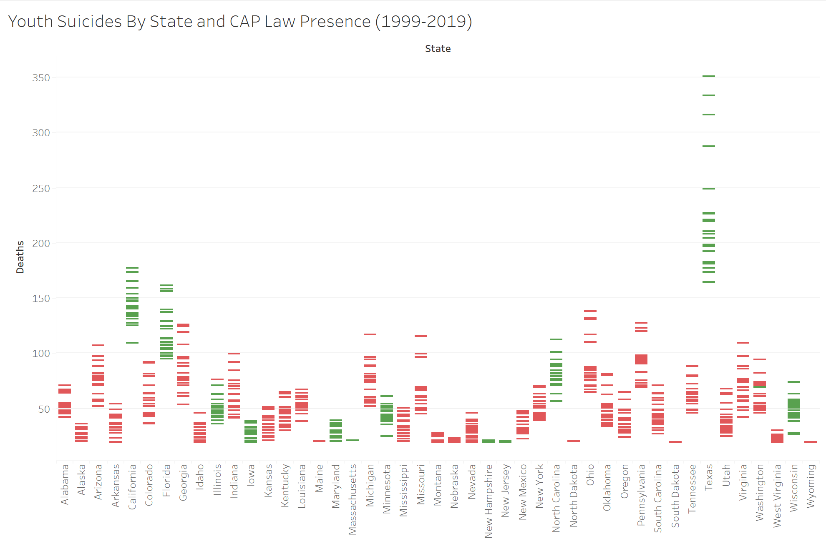
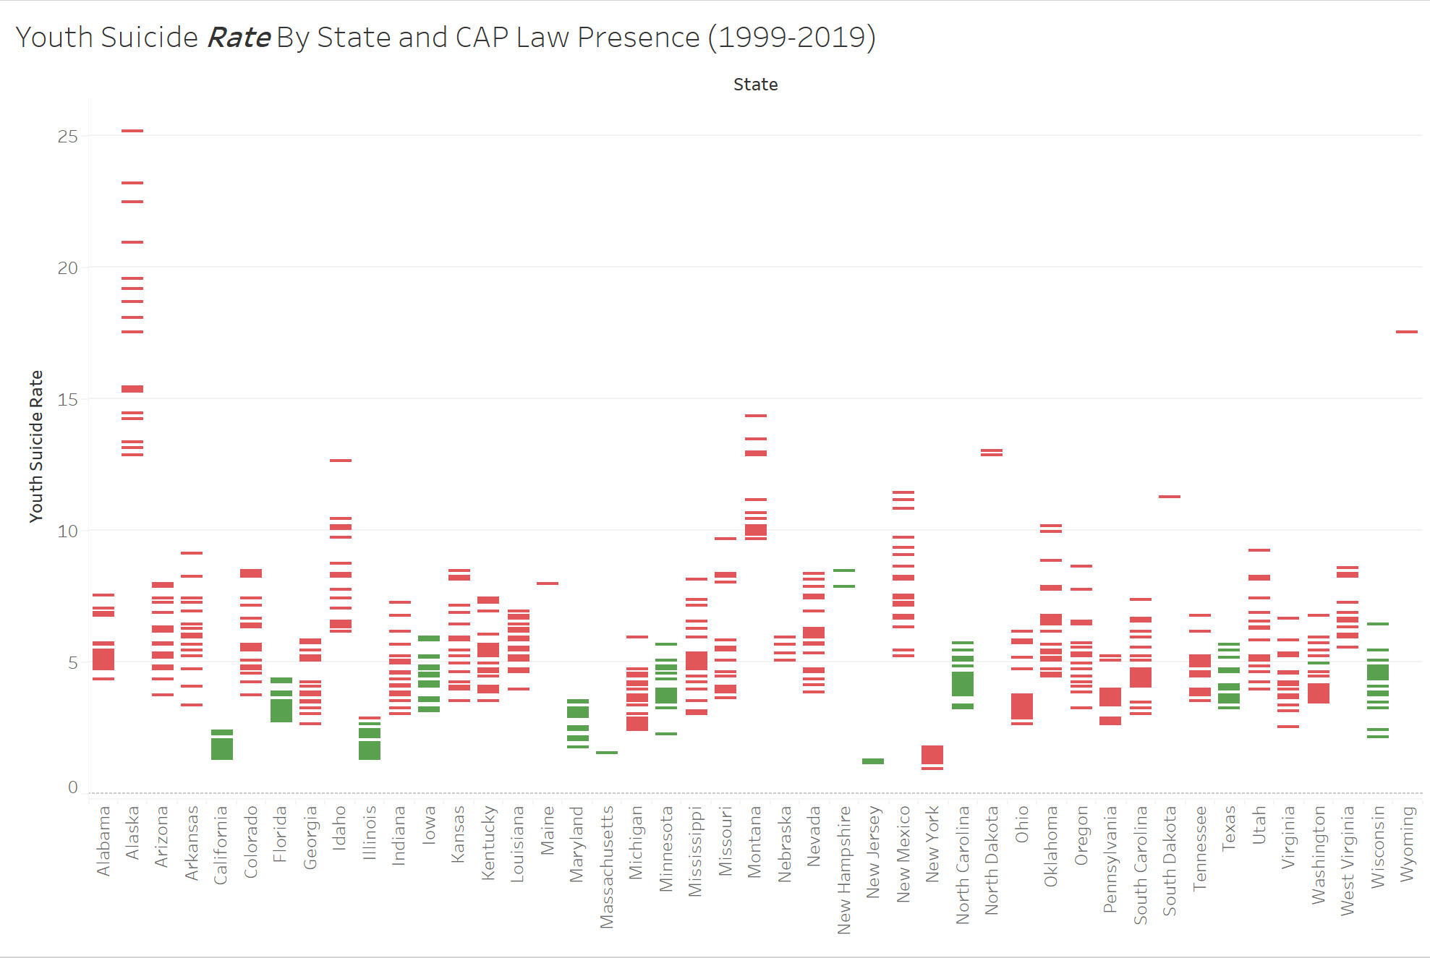

Slide 17
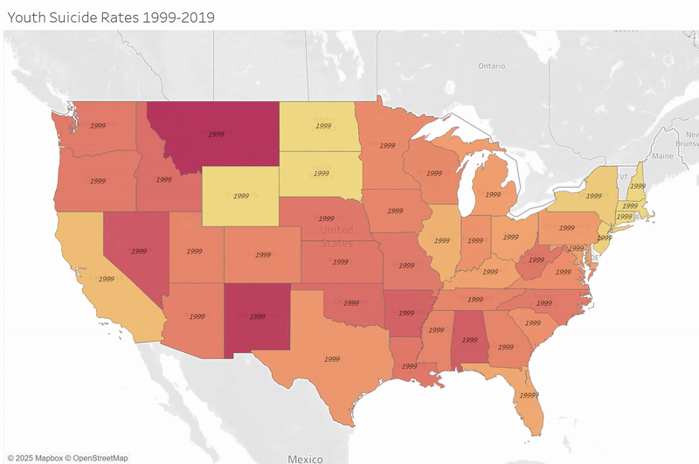
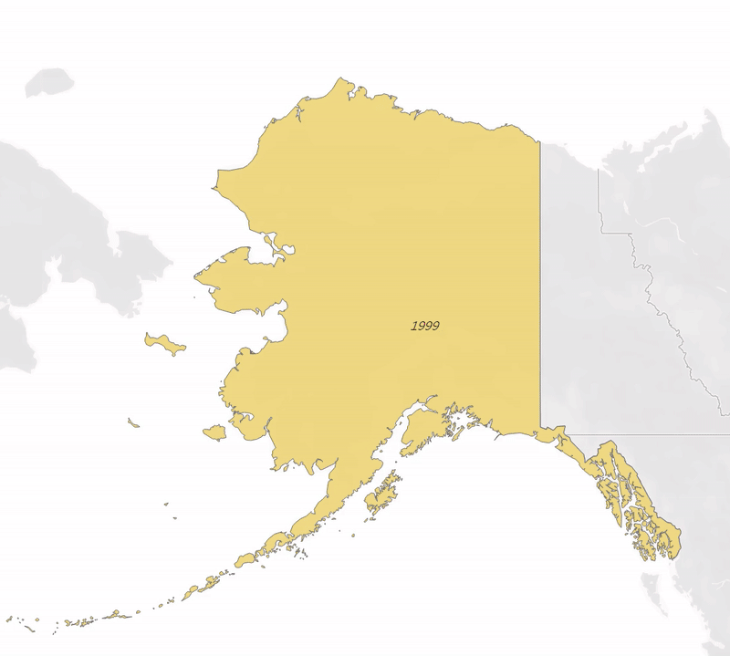

Slide 18
Methodology/Findings

Slide 19
Setting Up the Data
Data Collection
CDC Wonder Database
1999-2020 Multiple Cause of Death Request
*Some data points suppressed for privacy concerns (~13% of observations)
ICPSR database on gun laws (1991-2019)
Indexed all present CAP Laws together for this analysis
ACS-1 Data + 2000 decennial census
No ACS for 1999, 2001-2004
Imputed data via linear regression

Slide 20
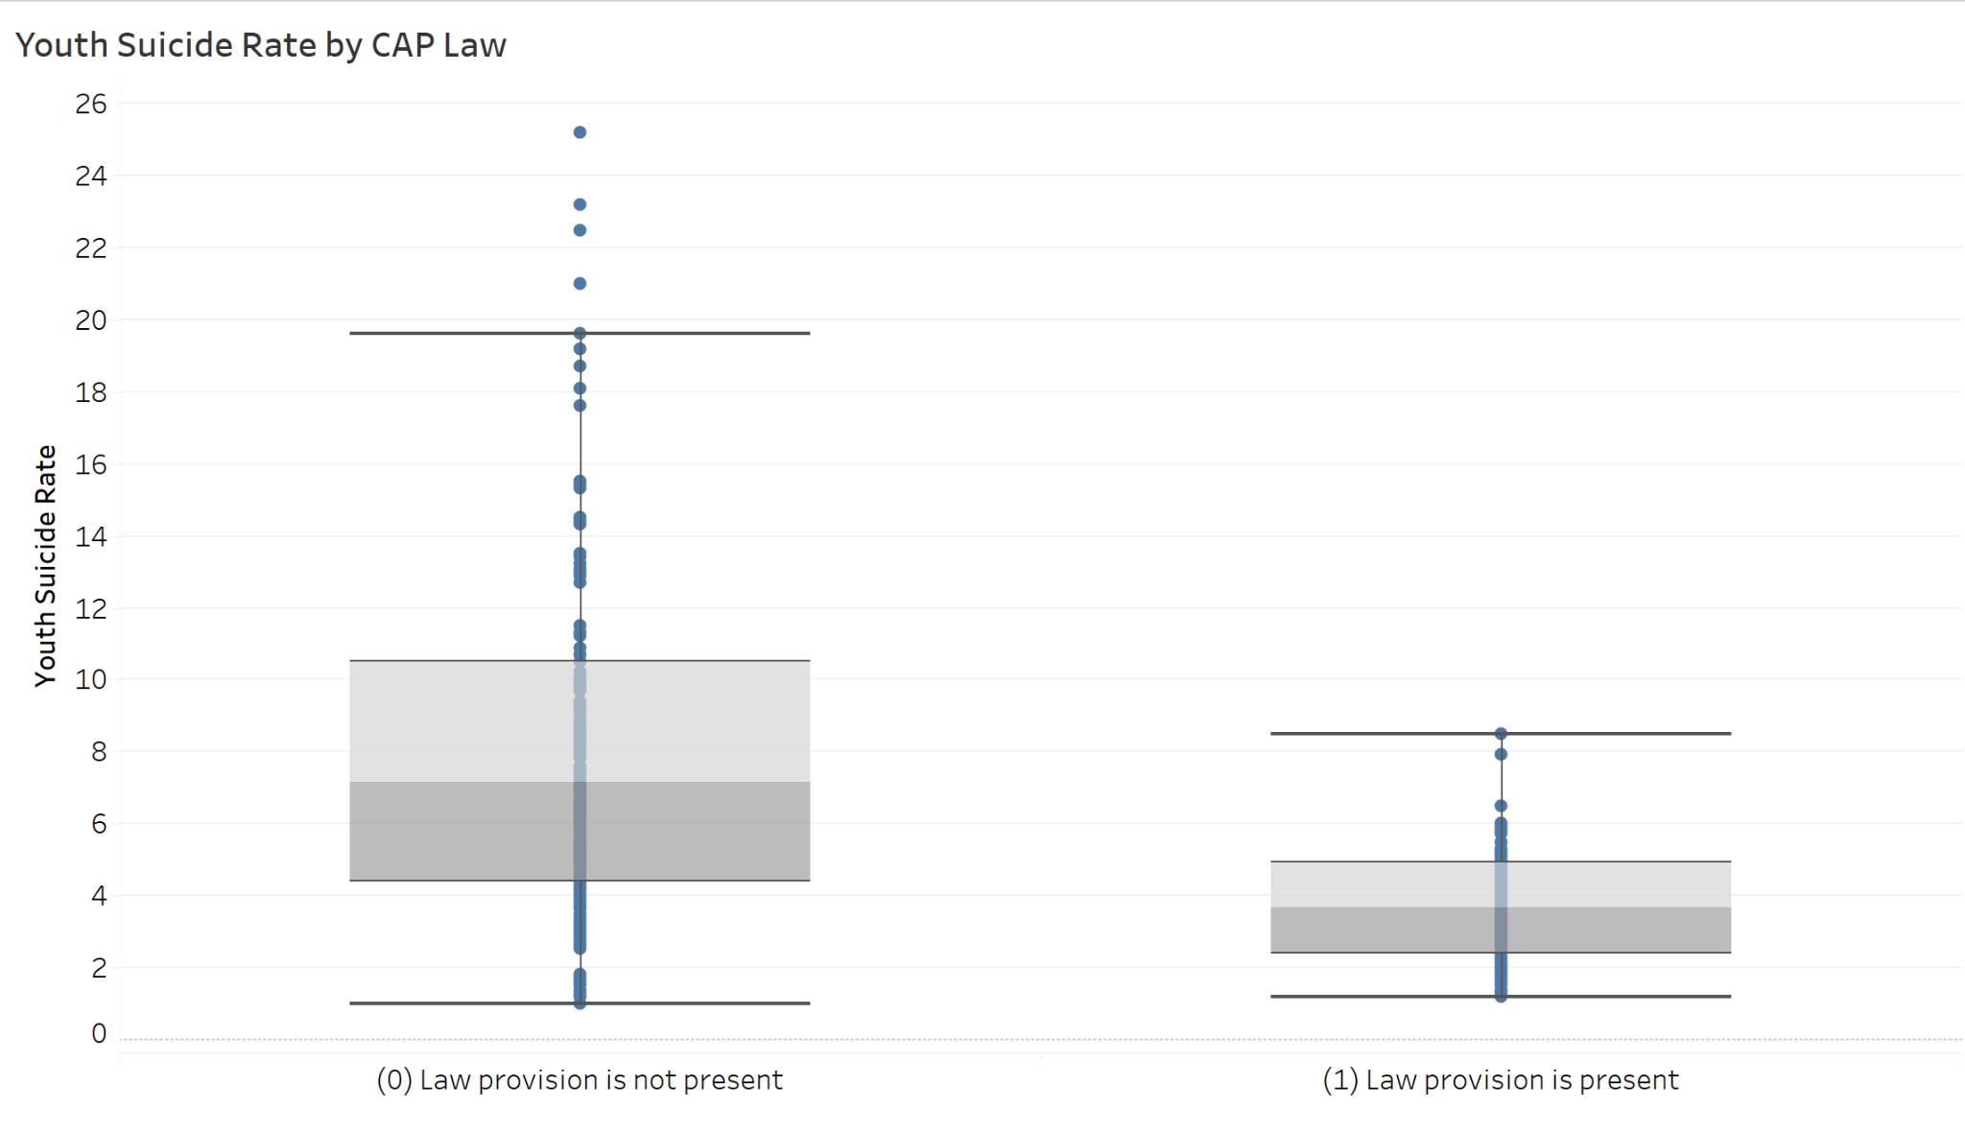
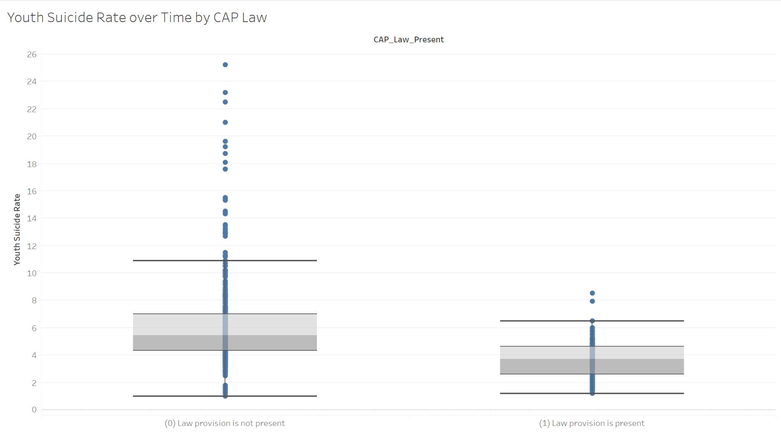

Slide 21
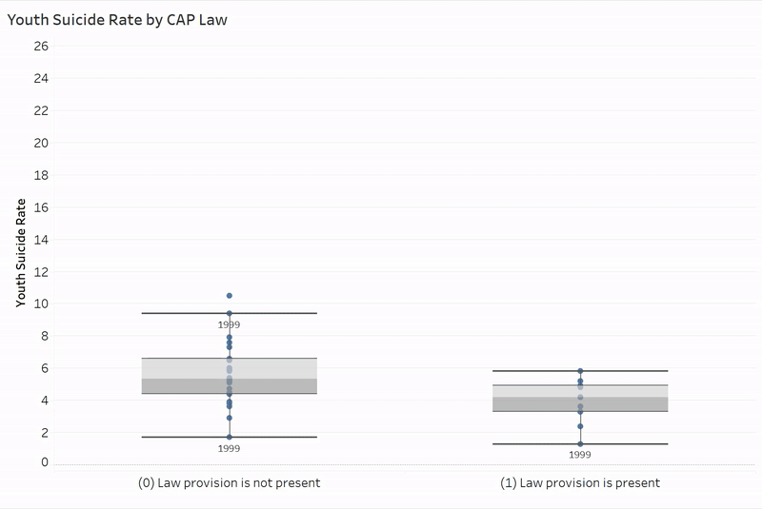
Preliminary Analysis:
Year-over-year, it seems like states where a CAP law is present have consistently lower youth suicide-by-firearm rates.
We want to isolate this difference from merely being a product of states being fundamentally different.

Slide 22
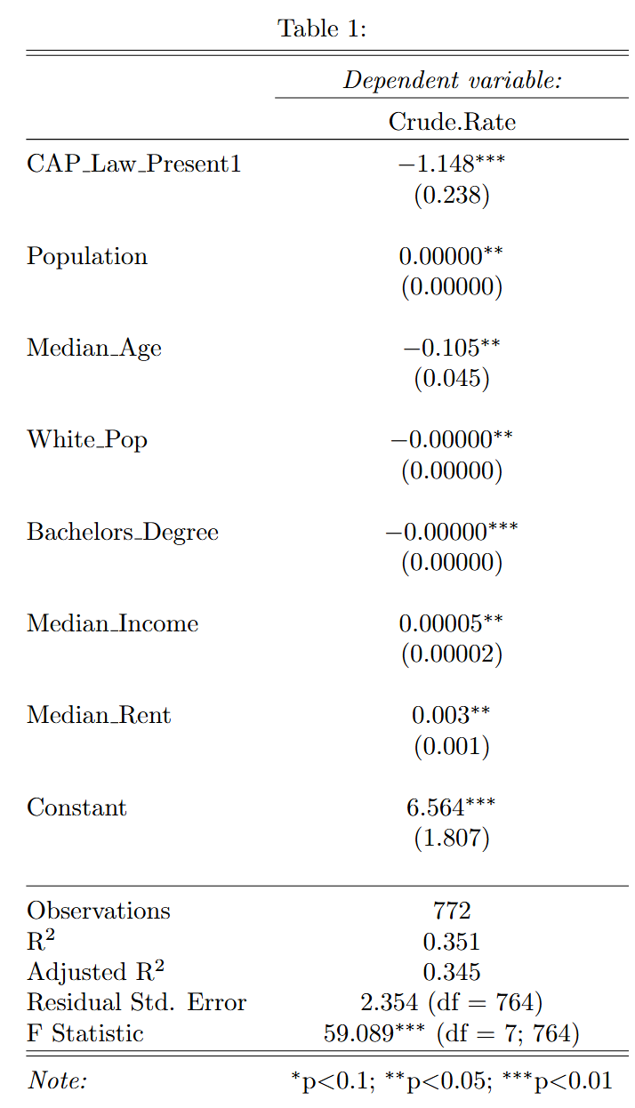
Approach One: Linear Regression
States with CAP measures are associated with a 1.14 unit drop in the youth suicide rate relative to states that do not have CAP measures with the listed controls.
This is an estimated 18% reduction in youth suicide rates at a statistically significant level.

Slide 23
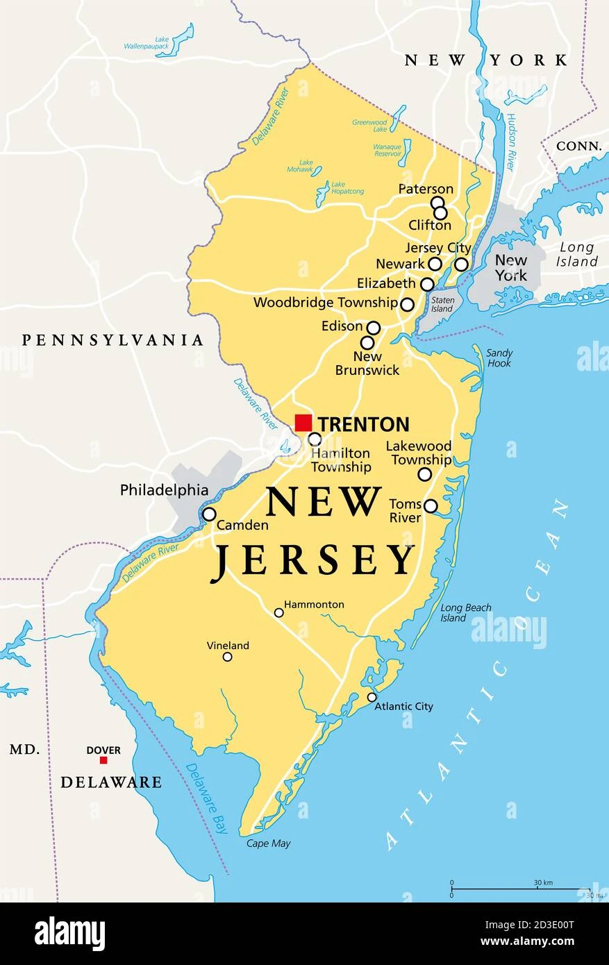
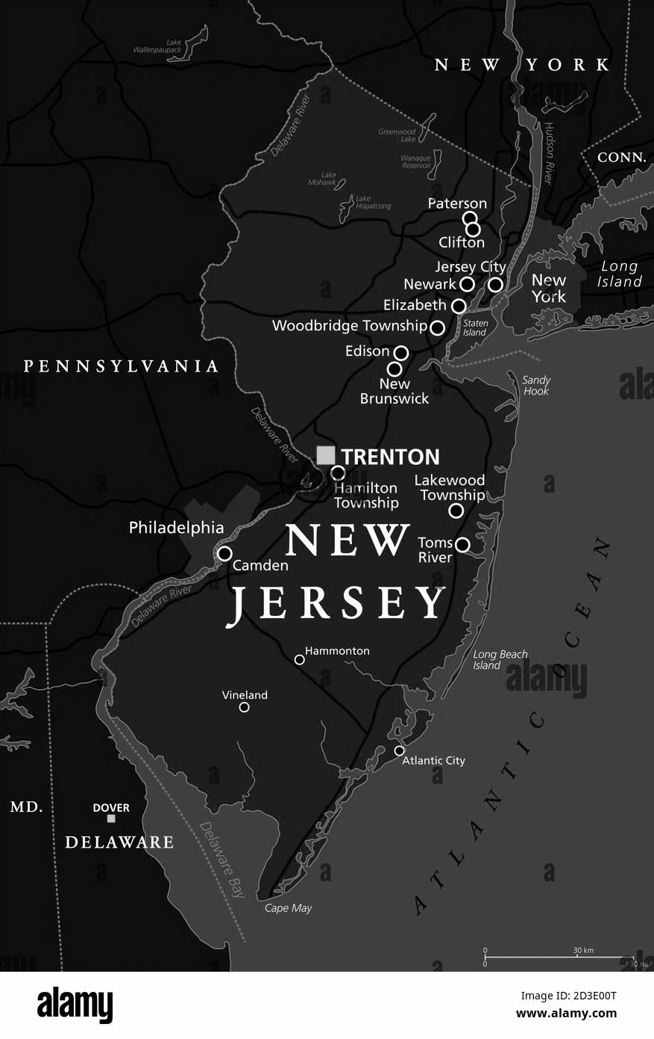
Approach Two: Propensity Score Matching
Other variables can still be significant when it came to explaining a difference in youth suicide rates, how can we really make sure that CAP laws do the work?
Propensity score matching: evaluating states that are essentially the same except for CAP Laws.
New Jersey
“Evil” New Jersey (Non-CAP)

Slide 24
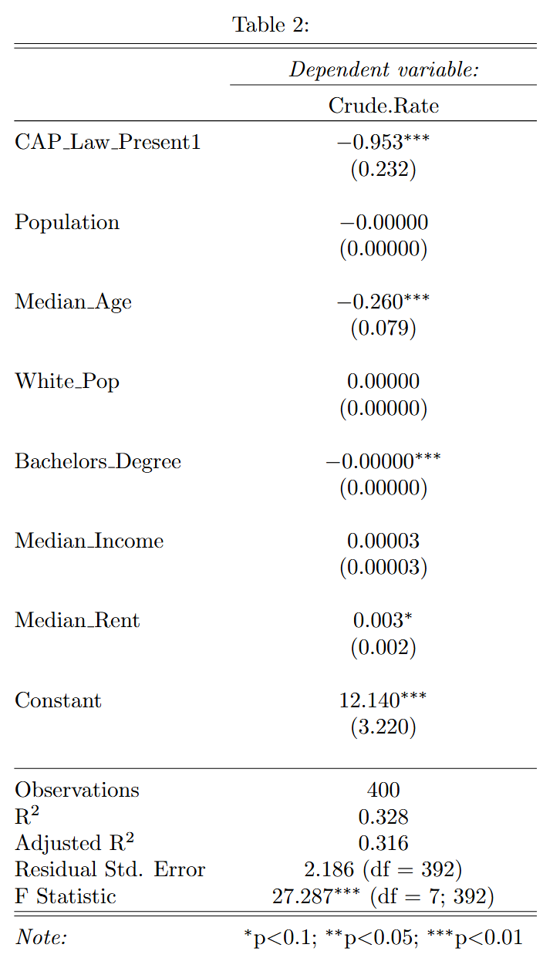
Model Two: PSM Regression
After matching, we have reduced our observations for analysis, but child-access prevention laws still prove to be significant in the reduction of youth suicide rates.
Even while matching and losing some of our dataset, we see a significant 8% reduction in youth suicide rates due to child-access prevention laws.
Both estimated models are likely an undercount of the effectiveness of CAP laws.

Slide 25
Limitations

Slide 26
Limitations
Data Limitations
CDC Wonder Data Suppression
Observations with fewer than 10 deaths are suppressed by the CDC for privacy concerns
Likely underestimated the effectiveness of CAP laws due to left-censoring by raw death count, but right-censoring by rate
Some smaller-population states had more suppressed observations but often had higher rates while some with CAP laws (Montana, Wyoming)
Others with sizable populations + CAP laws also did not pop as much (New Jersey)
ACS Data holes (1999, 2001-2004)
Impact on overall youth suicide is not provable with this method
Those considering suicide in a CAP-law state may be incentivized to attempt with other methods
Data and findings are not especially granular relative to individual CAP laws

Slide 27
Recommendations

Slide 28
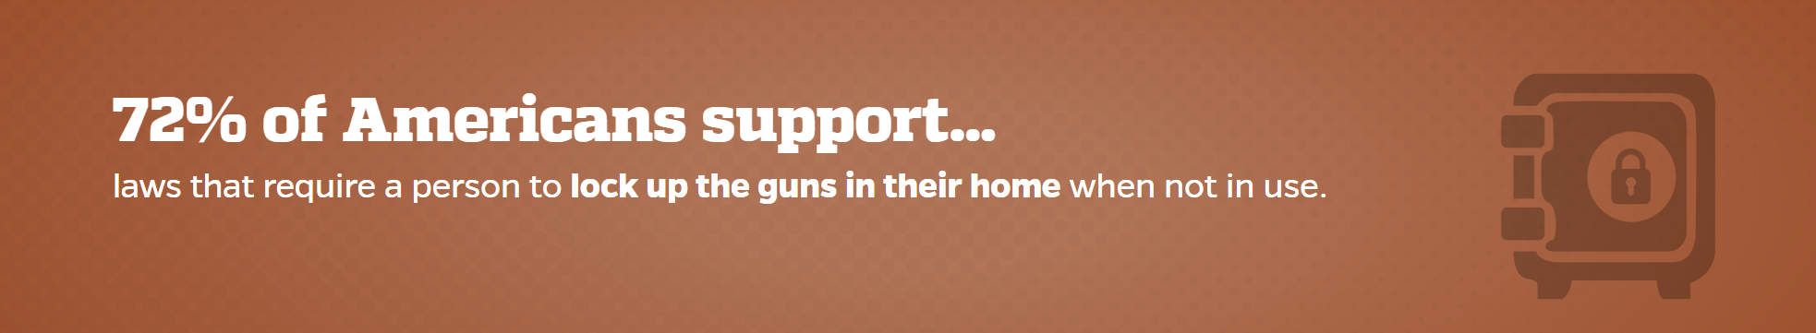
Recommendations
Moms Demand Action needs to prioritize child-access prevention laws over information campaigns as evidenced by the 8-18% reduction in youth suicide rates in this study, established prior literature, and general popularity.
More research needs to be done on the effectiveness of these laws in the following areas:
Youth firearm homicide
Violent crime
Mass shooting prevalence
Effects on gun storage practices
Effects on gun industry (firearms, ammunition, lockers)

Slide 29
Works Cited
Centers for Disease Control and Prevention, National Center for Health Statistics. National Vital Statistics System, Mortality 1999-2020 on CDC WONDER Online Database, released in 2021. Data are from the Multiple Cause of Death Files, 1999-2020, as compiled from data provided by the 57 vital statistics jurisdictions through the Vital Statistics Cooperative Program. Accessed at http://wonder.cdc.gov/mcd-icd10.html on Apr 2, 2025 8:14:28 PM
EVERYTOWN. (2022, June 2). The Rise of Firearm Suicide among Young Americans. Everytown Research & Policy. https://everytownresearch.org/report/the-rise-of-firearm-suicide-among-young-americans/
Johns Hopkins (2023). National Survey of Gun Policy | Center for Gun Violence Solutions. Publichealth.jhu.edu. https://publichealth.jhu.edu/center-for-gun-violence-solutions/research-reports/americans-agree-on-effective-gun-policy-more-than-were-led-to-believe
Miller, Matthew, and Deborah Azrael, “Firearm Storage in US Households with Children: Findings from the 2021 National Firearm Survey,” JAMA Network Open, Vol. 5, No. 2, 2022.
Schnitzer, Patricia G., Heather K. Dykstra, Theodore E. Trigylidas, and Richard Lichenstein, “Firearm Suicide Among Youth in the United States, 2004–2015,” Journal of Behavioral Medicine, Vol. 42, No. 4, 2019.
Sidman, Elanor A., David C. Grossman, Thomas D. Koepsell, Luann D’Ambrosio, John Britt, Evan S. Simpson, Frederick P. Rivara, and Abraham B. Bergman, “Evaluation of a Community-Based Handgun Safe-Storage Campaign,” Pediatrics, Vol. 115, No. 6, 2005.
Siegel, Michael. State Firearm Law Database: State Firearm Laws, 1991-2019. Inter-university Consortium for Political and Social Research [distributor], 2020-02-26. https://doi.org/10.3886/ICPSR37363.v1

Slide 30
Questions?

